Slide 1



Presentation Summary and Author
Name
PARUL SINHA
Course
BSC.IT
ID
444 9811
College
CIMAGE COLLEGE
Thank you for reviewing the steps for setting up a modern, automated development and deployment workflow.

Slide 2

Building a Git Repository, EC2 Setup, and CI/CD Pipeline
5 Steps to Modern Deployment
This presentation outlines the essential steps to set up a full continuous integration and continuous delivery (CI/CD) workflow, from initial code commitment to automated deployment on an AWS EC2 instance.

Slide 3





Step 1: Create Your Git Repository
Initialize Git Locally
Add and Commit Files
git init to start tracking changes in your project directory.
Stage your files with git add . and save the state with git commit -m "Initial commit".
Link to Remote Repository
Push Initial Code
Create your repository on GitHub (or equivalent) and connect: git remote add origin <REMOTE_URL>.
Upload your local repository content to the remote server using git push -u origin main.
Pro Tip: Establish a consistent naming convention for your main branch (e.g., 'main' or 'master') early in the process to avoid confusion during automation setup.

Slide 4
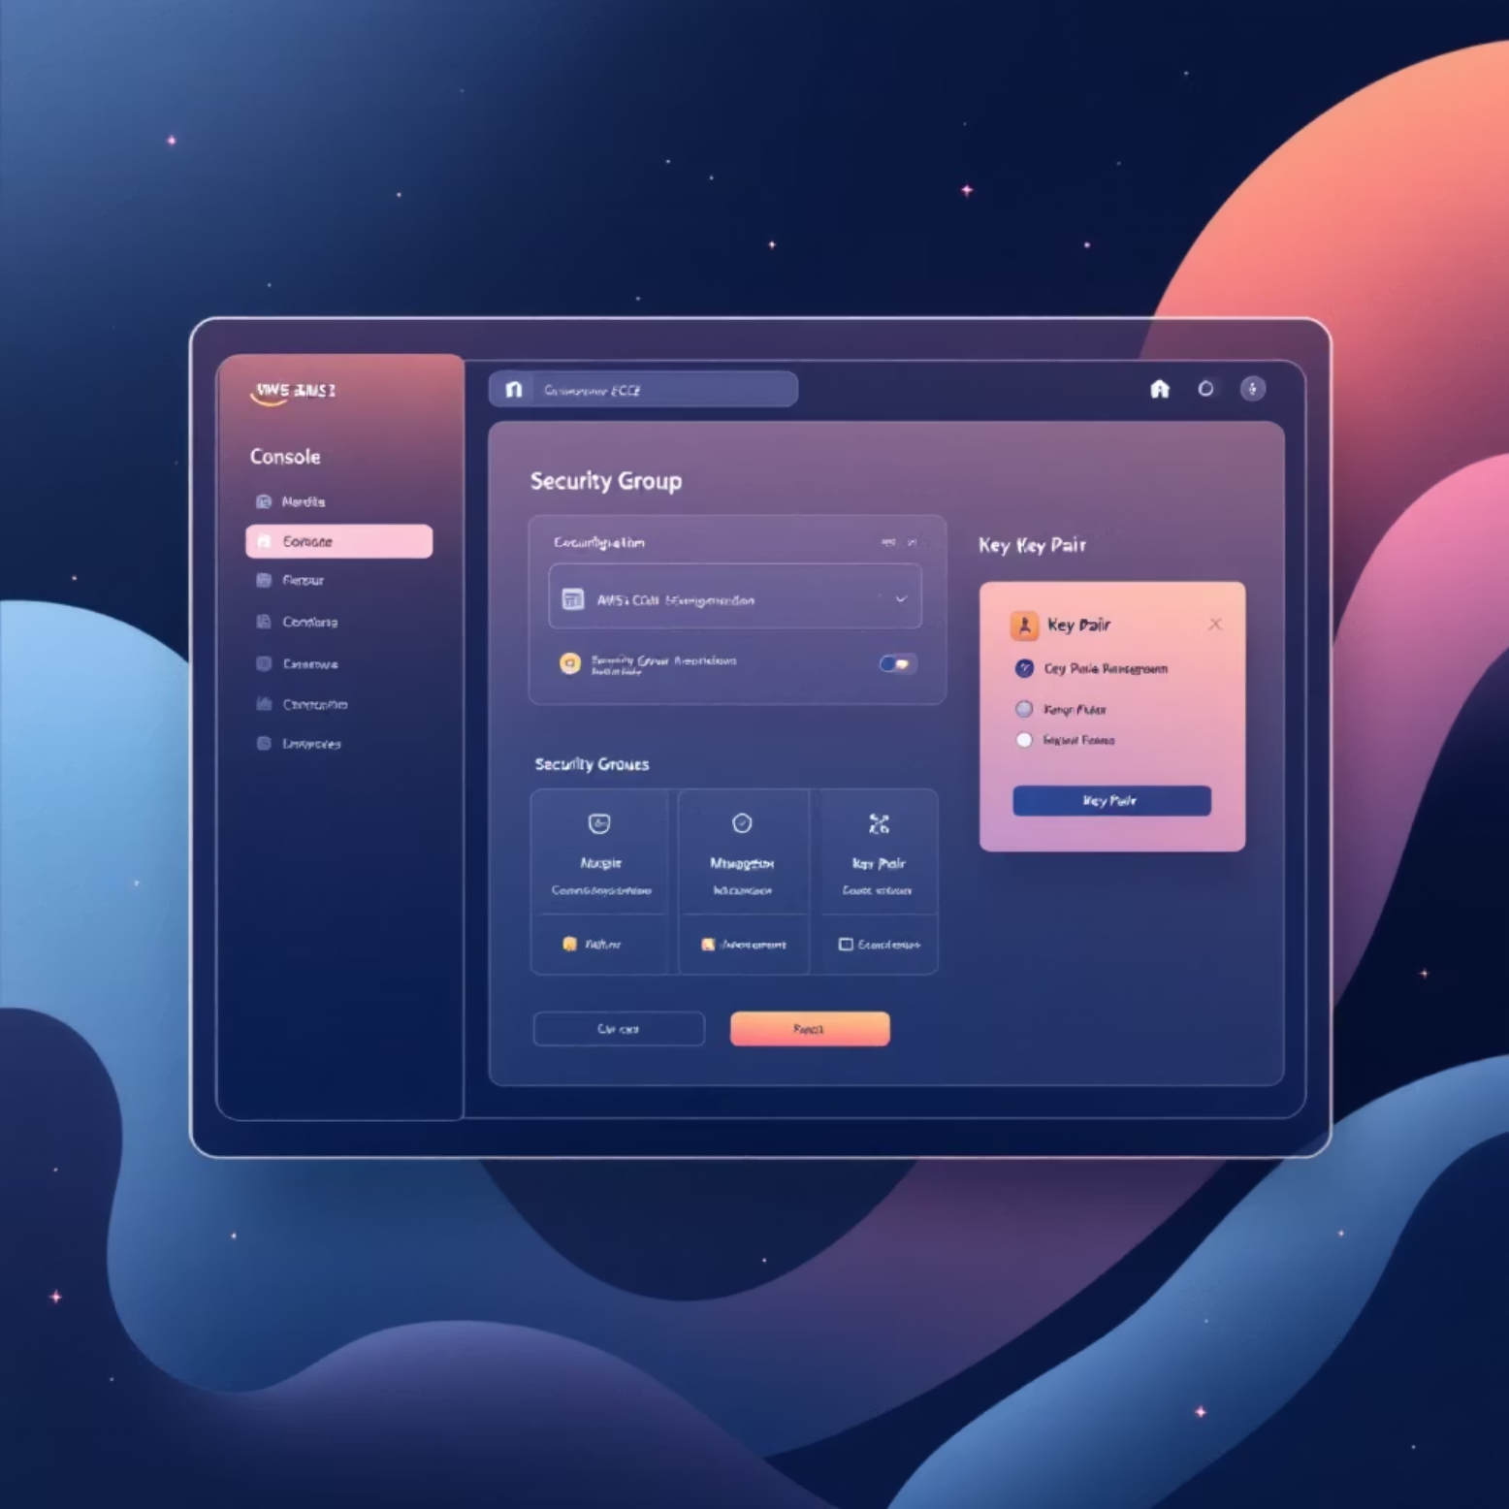

Step 2: Launch and Prepare Your AWS EC2 Instance
Launch Instance
Use the AWS Management Console to launch an EC2 instance (e.g., Amazon Linux 2 or Ubuntu).
Configure Security
Set up the Security Group to open port 22 (SSH) and your application port (e.g., 3000) to the necessary IP range.
SSH Access
Connect to the instance using your key pair: ssh -i <key.pem> ec2-user@<EC2_PUBLIC_IP>.
Install Dependencies
Install Git, Node.js, and PM2 (process manager) for running and managing your application in the background.
Set Up Deployment Directory
Create a dedicated deployment folder, like /var/www, and ensure appropriate file permissions.
Installation Commands (Amazon Linux):
sudo yum install -y git nodejs
sudo npm install -g pm2

Slide 5




Step 3: Clone Repository and Setup Application on EC2
Clone the Repository
Pull the code onto the EC2 instance into the prepared directory: git clone https://github.com/USERNAME/REPO.git /var/www/yourapp
Install Dependencies
Navigate to the app directory and install required packages (e.g., npm install for a Node.js application).
Run App with PM2
Start your application using PM2 to manage the process and ensure it restarts automatically if it crashes: pm2 start app.js --name "my-app"
Verify Live Application
Check that the deployment was successful by accessing the application via the EC2 Public IP address and port: http://<EC2_PUBLIC_IP>:3000

Slide 6
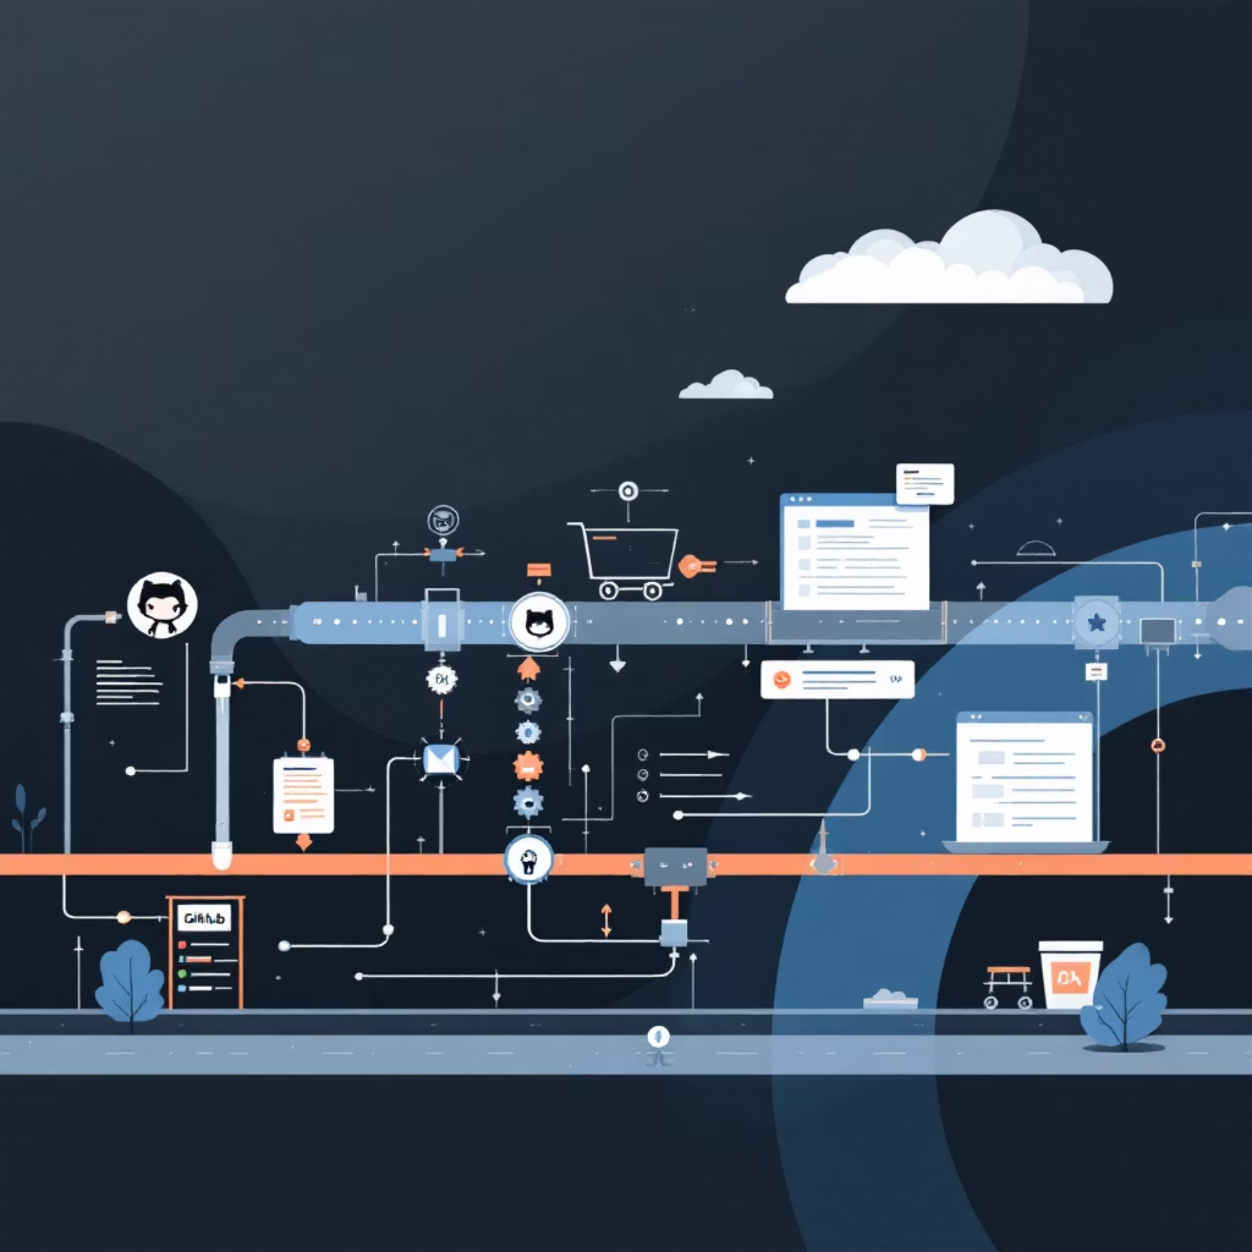




Step 4 & 5: Automate Deployment with CI/CD Pipeline
The final and most crucial step is automating the process using a CI/CD tool, such as GitHub Actions, to connect code changes directly to deployment.
Trigger Workflow
The CI/CD pipeline is configured to automatically initiate upon a git push to the main branch.
Secure SSH Connection
The workflow securely connects to the EC2 instance using stored credentials (SSH key secrets).
Code Deployment
The pipeline executes a git pull command on the EC2 server to fetch the latest code changes.
Restart Application
The final step uses PM2 commands (pm2 restart my-app) to reload the application with the new code, completing the deployment.
This automation ensures that every verified code change is quickly and reliably pushed to the production environment without manual intervention.

